Slide 1

ORGANIZATIONAL STRUCTURE
To organize the world's information and make it universally accessible and useful.

Slide 2
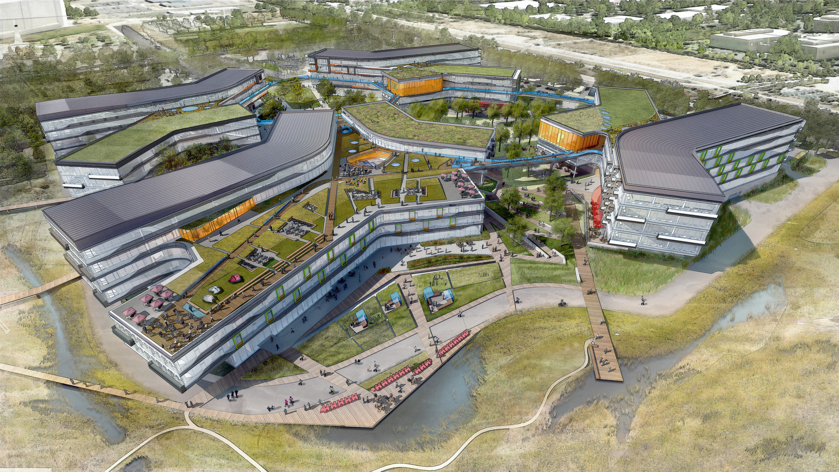
‘s Headquarter
To organize the world's information and make it universally accessible and useful.

Slide 3
?
What is
World largest search engine
More than 40,000 empoyees in 2021
Receive over 2 millions resume each yeat
Google has topped the list of Fortune 100’s “Best Companies to Work for” again in 2021 for a grand total of four times.

Slide 4
What Are The Secrets?

Slide 5
1. Fun Work Environment
Employees can get free meals : breakfast, lunch, dinner, and snacks.
The company provides in-house basic health and dental checkups.
You can also get haircuts from professional hairdressers.
There’s unlimited dry cleaning available.
You can get massages from professional masseurs.
You have access to top-of-the-line gyms and swimming pools.
You can catch up on sleep with in-house nap pods.
You’ll find several video game stations across Google offices.
Table sports such as football and table tennis are there, too.
Video:
https://www.youtube.com/watch?v=Z-pT0XDYvDM

Slide 6
2. Thorough Hiring Process for the Brightest and the Best
less than 0.5% of all over 2 millions applicants actually being hired.
assessing not only technical skills and intellect , but also his creative thought process and quick thinking abilities.
The company does not use work experience as a major criterion for selection.
Interviews at Google consist of curveball questions like
“How many golf balls can fit in a school bus?” or
“You are then thrown into an empty glass blender. The blades will start moving in 60 seconds. What do you do?”

Slide 7
3. Making HR into a Science
based most of its decisions on data and analytics.
From retention algorithms that predict which employees are most likely to leave the company, to studies revealing the optimal size and shape of cafeteria tables
Data & Analytic
how long are you willing to wait in line for lunch?
Google concludes that the optimal time for people to stand in line waiting for lunch is about 3 to 4 minutes
Any longer and the person in line is wasting precious time
any shorter, that person won’t be able to make meaningful dialogue with others in the line
Example 1
how they solved its retention problem with female employees?
found that women were leaving the company at twice the rate
HR department identified the main issue to be the maternity leave plan for new mothers.
they changed the plan so new mothers could get 5 months paid time off instead of 12 weeks, Google’s attrition rate for women dropped by 50%!
Example 2: Retention

Slide 8
4. Casual, Democratic Atmosphere
a “flat” company, with smaller number of middle managers and an upper management
This lack of top-down hierarchy cultivates a more open atmosphere for employees to voice their opinions and new ideas in various ways

Slide 9
5. Clear Mission and values: why you do what you do?
Some of company sayings: “It’s best do one thing really, really well” and “Fast is better than slow” have all shaped the core of its company culture, providing principles that Googlers can rally around as a compass for day to day behavior.
Google use 70%, 20%, 10% model:
70% use on their core work
20% on related project
10% on side project or your own project

Slide 10
6. Practicing transparency and open-door environment
Sharing information through weekly meeting establishes transparency in the office creating an environment where everything is up for debate
Founders Larry and Sergey host the event, where employees from around the world are encouraged to ask, then vote online on questions they most want answered.
Keeping the employees updated about where the company is headed and why it’s going in the direction it’s going in will help the employees feel like a part of something greater than just a conglomerate of anonymous individual.

Slide 11
7. Employee Recognition for Small and Big Contributions
provides incentives for employees to do the best work they can
rewards paid in the form of Google Stock Units
mistakes are praised
Before she became the COO of Facebook, Sheryl Sandberg was a vice president at Google whose responsibilities included managing their automated advertising system.
When she made a mistake that cost Google several million dollars, she admitted her error to co-founder Larry Page
he said: “I’m so glad you made this mistake,”. “Because I want to run a company where we are moving too quickly and doing too much, not being too cautious and doing too little. If we don’t have any of these mistakes, we’re just not taking enough risk.”
Employee appreciation leads to a fearless office culture, where people are more willing to take risks.
The Founders’ Award
Failure’s Award

Slide 12
8. Organizational Culture Boosted By Community
Engagement Outside of Work
Google has contributed $1.2 billion dollars to the Berkeley County, data center facilities as a long term investment, along with close to $1 million for charitable causes in South Carolina.
Events like Googlefest (a professional and personalized learning conference for educators) provide opportunities for employees to become involved in community building and training.
Commitment to community is one of the leading indicators of a great corporate culture.

Slide 13
References
https://www.businessinsider.com/kyle-westaway-how-to-manage-your-career-2012-11
https://www.businessinsider.com/kyle-westaway-how-to-manage-your-career-2012-11
https://www.cnbc.com/2021/12/16/google-20-percent-rule-shows-exactly-how-much-time-you-should-spend-learning-new-skills.html
https://www.tinypulse.com/blog/10-great-examples-of-googles-company-culture
https://www.youtube.com/watch?v=Z-pT0XDYvDM
https://www.ukessays.com/essays/commerce/hr-strategies-that-google-has-implemented-commerce-essay.php
https://panmore.com/google-hrm-recruitment-selection-retention#:~:text=Google's%20Recruitment%20Practices&text=Google's%20human%20resource%20management%20uses,recruitment%20sources%20for%20HR%20needs.
https://officevibe.com/blog/7-secrets-of-googles-epic-organizational-culture
https://www.studysmarter.us/explanations/business-studies/business-case-studies/google-organisational-culture/

Slide 14
Thank You!
Is there any questions?

